Slide 1
Fostering Migrants Employment in the Construction Sector

Slide 2
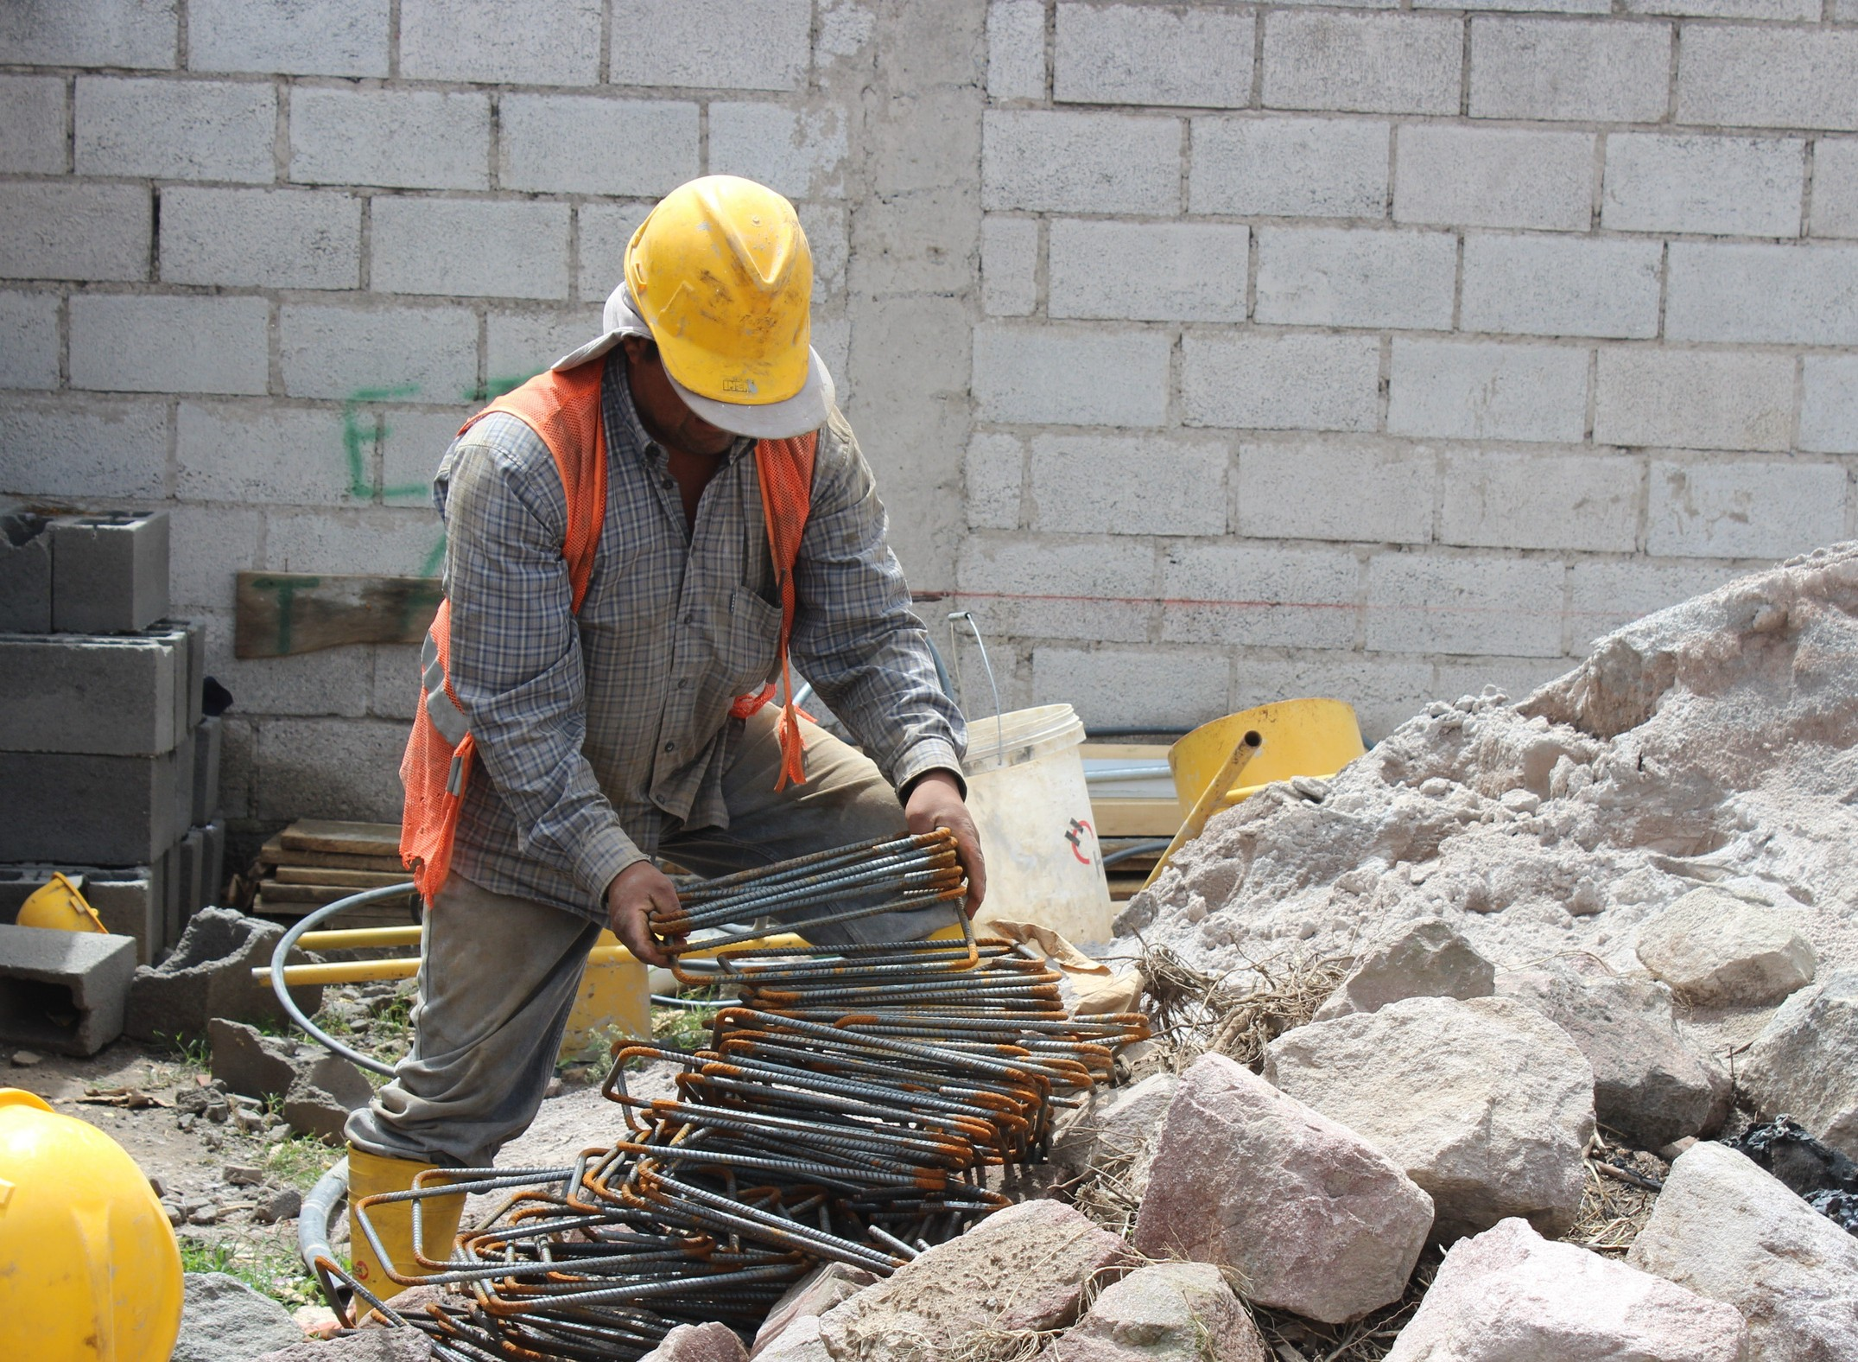
MITRUST Project Presentation

Slide 3
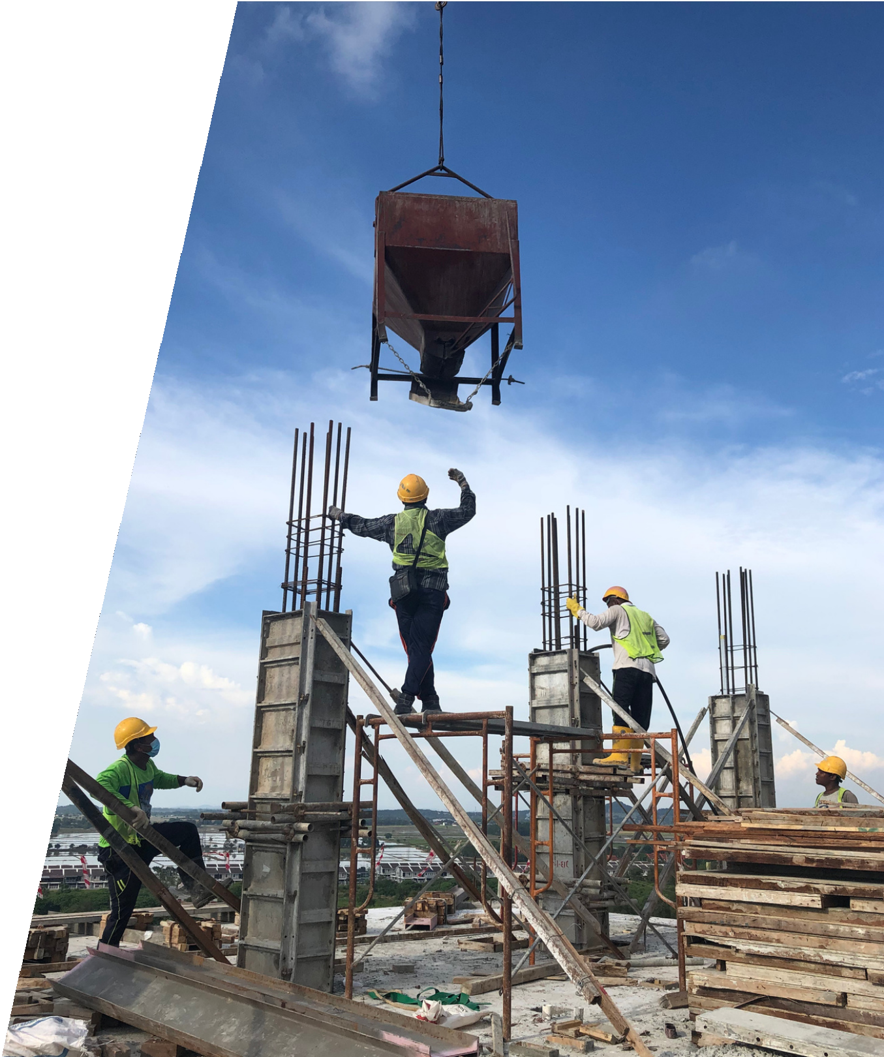
Introduction
Construction accounts for 11-13% of the global GDP (Gross Domestic Product)
One of the main objectives of the Construction 2020 EU Strategy refers to the improvement of the human capital
Construction is one of the top 10 principal sectors of employment for migrants in the EU
A key aim of the BUILD UP Skills initiative with specific attention to vocational training

Slide 4
Barriers to the training of building workers
There are several specific barriers:
- Lack of new technologies that support the access of migrant workers to training
- Cultural and linguistic barriers may also pose a difficulty in attending training
Thus, low-skilled migrant workers are at risk of losing their jobs

Slide 5
Globalization and technological changes have affected the EU construction
For this reason:
- building workers are forced to equipe with new skills (technical, soft, and language skills)
- there is more need for VET support
- there is still a lack of investment in skills training by construction companies, due to a variety of reasons (market failures, unaffordable costs, etc.)

Slide 6
COVID-19 impact
Language learning of construction terminologies was happening on-the-job place and time until now
- COVID-19 impact has affected this type of learning due to the demand of keeping social distancing and working as remotely as possible.

Slide 7
MiTRUST aims

Slide 8
MiTRUST aims
MiTRUST aims to develop and deliver an innovative digital tool with the intention to support migrants who would like to work in the Construction Sector to acquire the:
necessary language competencies
soft skills
and proper behaviours on the construction site
The project focuses on targeted open and distance learning opportunities which will offer better career perspectives to migrants who want to enter in construction industry

Slide 9
Who this course is for?
Migrants working or supposed to work in the Construction Sector

Slide 10
Target group
Migrants
VET Tutors/Trainers
VET providers
Construction firms and companies
Migrants’ associations
Stakeholders and policymakers

Slide 11
Course Curriculum
This course includes 3 Open Educational Resources:
E-linguistic support tool
Soft Skills Curricula
Construction Pedia
Self-assessment tool

Slide 12
THANK YOU
Migrants Trust
Migrants Trust
Migrants Trust
https://www.migrantstrust.com/en/

